Slide 1




MOOD
A Smart Coffee Machine
Smart Sensor Switch
Mood & Health
Customisation
Automatic Brewing
Auto Activate
Auto Hibernate
Customise coffee to suit users’ mood and health.
Users can enjoy leisure time without manual operation.
WHAT IS IT?
Energy Efficiency
Interaction
Brewing & Completion
Automatically activates when nearby and enters sleep mode when away to reduce energy consumption.
Using facial recognition and biological signals to assess the user's state and recommend coffee types.
Music plays during brewing to relax, with a completion reminder to ensure fresh coffee.
WHY DO IT?
Detection of
Biological Signals
Judgment of
Biological Signals
Implementation
- Image Recognition
- Biological Signal Capture
(Heart Rate, Blood Oxygen)
- Judgment of Healthy Heart Rate and Blood Oxygen Levels
- Classification and Recognition of Mood States
- Coffee Actuator
- Custom Preferences
- Mood Enhancement Module
HOW TO DO IT?
Grosso, G., Micek, A., Castellano, S., Pajak, A. and Galvano, F. 2016. Coffee, tea, caffeine and risk of depression: A systematic review and dose–response meta-analysis of observational studies. Molecular Nutrition & Food Research. 60(1), pp.223–234.
Notes:
TangQi:
We combine biological signal detection, like heart rate and blood oxygen levels, with image recognition to analyse the user’s physical and emotional state. The system calculates the state of emotions, such as happiness, based on these inputs. Using this data, the recognition module matches the mood with the best coffee option and automatically brews a drink to enhance the user’s mood or meet their preferences.
ZhengJunTeng:
First is efficiency—the machine auto-activates and sleeps based on user presence, reducing energy consumption. Next is interaction—it intelligently recommends coffee based on physical condition. Finally, it plays music throughout brewing for relaxation and ensures fresh coffee. These innovations provide practical advantages that do not exist in specific coffee machines.

Slide 2
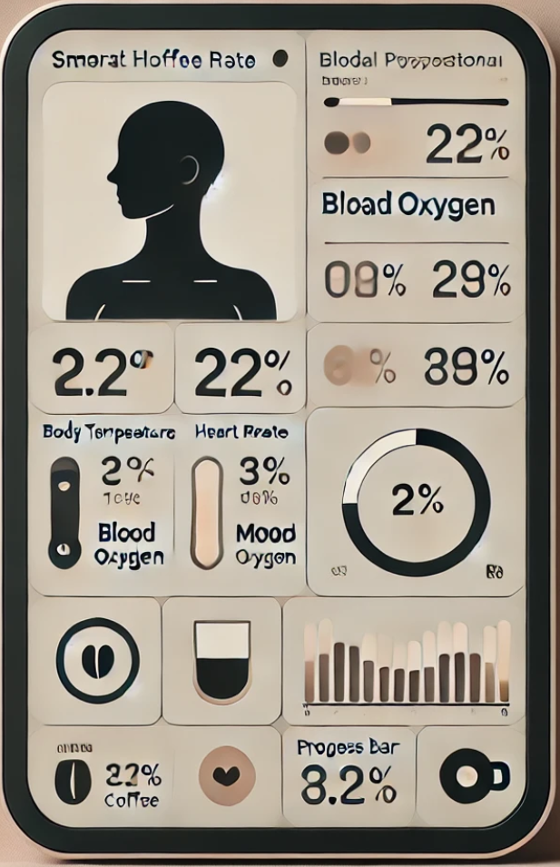
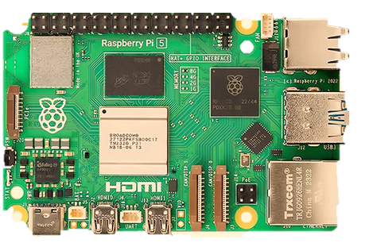
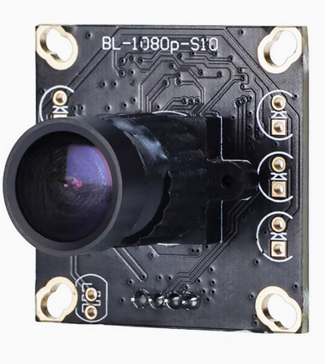
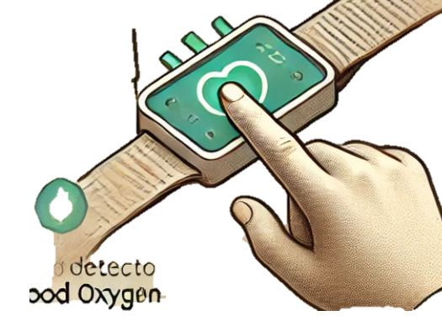
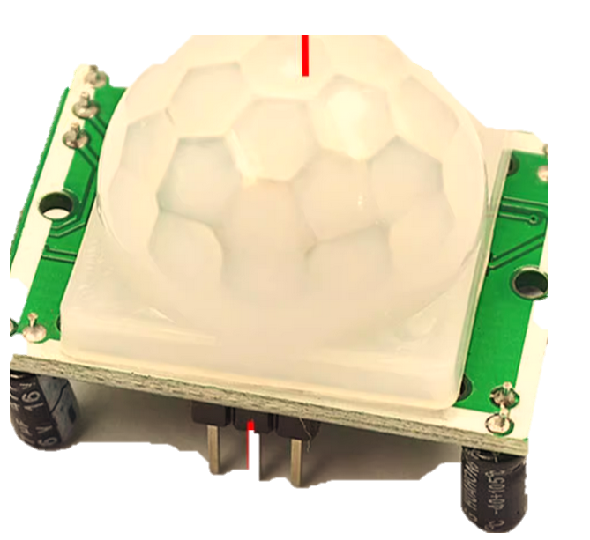
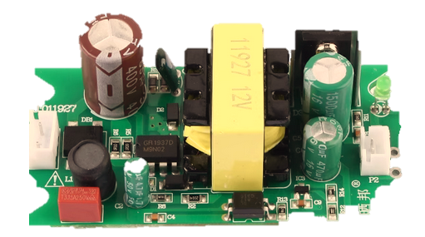
MOOD
A Smart Coffee Machine
Main Progress
Physical signs
Mood recognition
Coffee maker
Audio module
Display module
Cardiotach measure
Image capture
Motor
Valve
Speaker
Screen
Screen
Scene display
Keep it alive
Raspberry PI
Wake it up
Fed dog
Daemon Progress
Timer
Body sense
Camera
Cardiotach ometer
Infrared sensor
Power module
Notes:
This picture basically describes the hardware connection structure of our smart coffee machine, including input peripherals such as camera, heart rate module, infrared sensor module and output peripherals such as display screen and speaker.
The right-side picture shows the software framework of our project. We expect to have two processes, with the main process containing five child threads: emotion detection, health detection, coffee making, sound, and display. The daemon thread is responsible for keeping main process alive and waking it up.
A: Display module will be responsible for feeding dog. It will contain the rest threads running conditions. We may adopt an AND gate to decide whether to fed dog.

Slide 3
Main Progress
Physical signs
Mood recognition
Coffee maker
Audio module
Display module
Cardiotach measure
Image capture
Motor
Valve
Speaker
Screen
Keep it alive
Wake it up
Fed dog
Daemon Progress
Timer
Body sense

